Slide 1
Measuring abdominal compliance for laparoscopic procedures
Jan Mulier
Jose Lara Tamayo
9:15 – 10:15
10:30 – 11:30
Friday17 feb 2012
Workshop session IBIZA

Slide 2
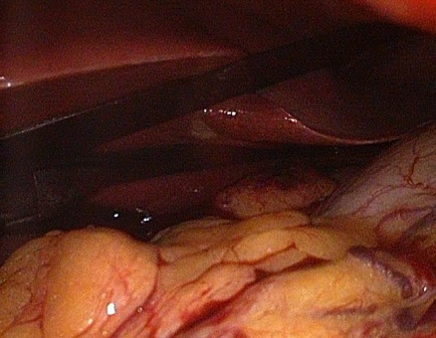
Can we do something to improve the situation?
Surgeon: I haven´t enough workspace
Anesthesiologist: I am OK
Surgeon: Look at the video screen. I can´t work
Anesthesiologist: If you want more volume, you should increase the pressure
Surgeon: ¡¡¡But it is over 18 mmHg!!!
Anesthesiologist: The patient has only one TOF response in the AP. Last time this was enough. Why not today?
Surgeon: I don’t know what “one TOF response” means. What I said is I can´t work
Intraabdominal pressure ?
Intraabdominal volume?
Workspace?

Slide 3
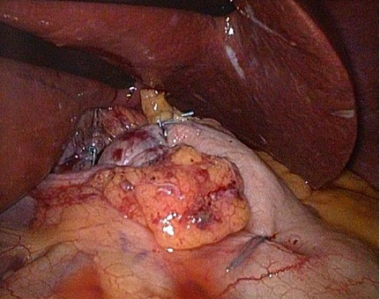
¡¡¡¡¡ YES WE CAN !!!!!
Surgeon: Now I have very good surgical conditions
Anesthesiologist: The patient is OK
Surgeon: Look at the screen. I have enough workspace and the IAP is low
Anesthesiologist: The patient is now on a deep neuromuscular block
Surgeon: How many PTCs has the patient in the adductor pollicis?
Anesthesiologist: only 3 PTCs. I will keep him on a deep NMB until the end
Surgeon: Thanks. Then we will end in time and can have drink afterwards.

Slide 4
Question
Did you experience an unhappy surgeon telling you he has no workspace?
Did you use NMB? Did you use NM monitoring?
  was NMB moderate or deep?
Can you remember some patient data?
  Morbid obese?
  Man versus woman?
  First laparoscopy?
  Previous surgery?
What did you/surgeon do and was the surgeon pleased?

Slide 5
Let us measure the abdominal compliance and understand what happens
Laboratory set up to measure of abdominal compliance.
Clinical measurement at the start of laparoscopy
Fast clinical guess at first insufflation

Slide 6
1. Laboratory measurement
First inflate abdomen and place large trocar
  Verify position of trocar
  Stomach and bladder empty?
Deflate abdomen while palpating abdomen
  Making repetitive measurements possible in the same condition.
Slow inflation/deflation of pneumoperitoneum
  Measure flow and pressure (P) continuous
  Calculate inflated volume: V
  Set out in P/V loop
  Linear fit of curve: calculate P = E . V + PV0

Slide 7
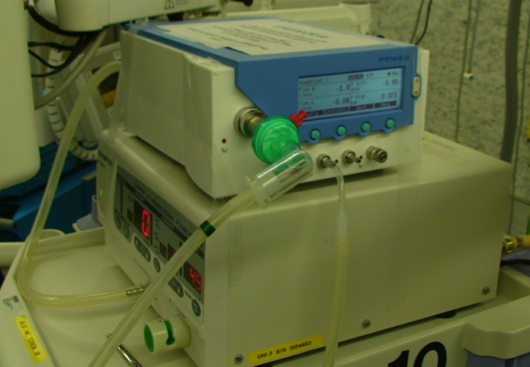
1. Laboratory set up
Flow and pressure monitor between insufflator and abdomen
Slowly inflate and deflate the abdomen while measuring pressure and integrating flow to volume

Slide 8
What is abdominal compliance in man?
The Abdominal pressure volume relation (APVR)
  Compliance C:
    change in volume/change in pressure
  Elastance E: E=1/C
    Change in pressure/change in volume
  PV0: Crossing of Y axis
    Pressure at zero volume
APVR is linear in humans
  To a value of 20 mmHg
  Except if abdomen has an apple shape.
    central obesity with intra abdominal fat

Slide 9
Diameter cirkel daalt bij opblazen buik
Abdomen als vast onderstel
met rekbaar vlies bedekt
Mulier JP 2008

Slide 10
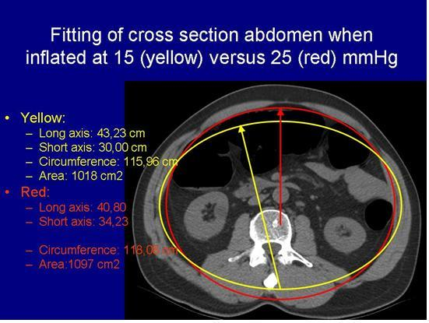
CT scan
Mulier J.P., Coenegrachts CT analysis of the elastic deformation and elongation of the abdominal
wall during colon inflation for virtual coloscopy
Eur J Anesthesia 2008 Suppl

Slide 11
Examples of P V loops in the abdomen

Slide 12
2. Clinical calculation at start of pneumoperitoneum
PV0 and the C can be easely calculated at the start of pneumoperitoneum.
  During procedure: deflation and reinflation while no leak.
Inflate to 0,5 L; 1 L; 1,5 L or 1L; 2L; 3 L
  Stop insufflator and measure lowest value (end expiration)
Set out in PV diagram and fit linear line
  PV0: Crosses with Y axis
  E = 1/C: Angle of line

Slide 13
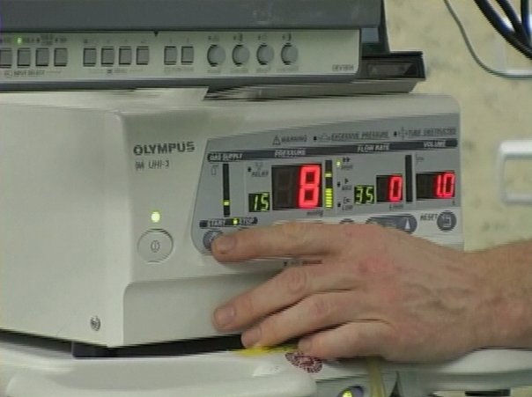
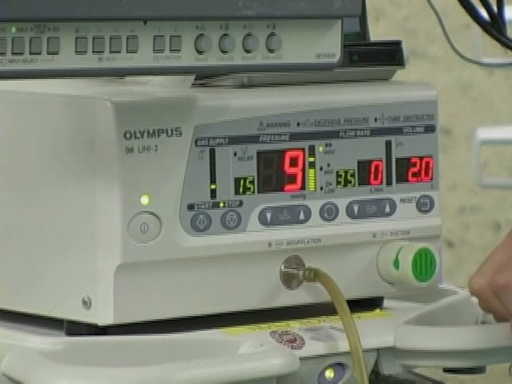
2. Simplified three points measurement of abd C
Volume 1 L Pressure 8
Volume 2 L Pressure 9
Volume 3 L Pressure 10
PV0 : 7 mmHg
E: 1 mmHg/L
C: 1 L/mmHg

Slide 14
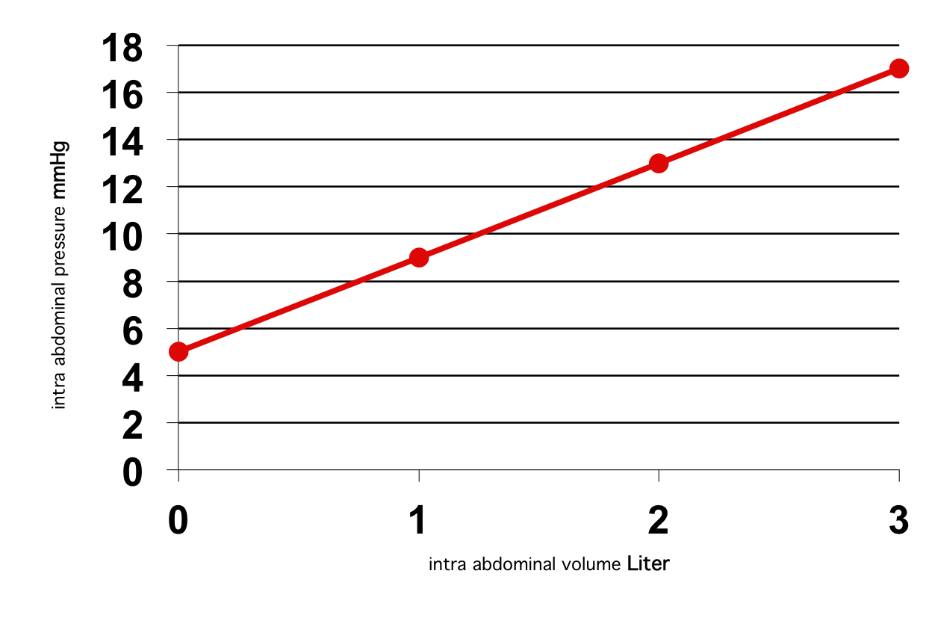
Compliance (C) and Elastance (E)
C=change in V/change in P (C= 1/E)
Higher insufflation pressures needed
PV0 = 5
E = 4 mmHg/l
Insufficient intra abdominal volume
J Mulier, B Dillemans, M Crombach, C Missant, A Sels
On the abdominal pressure volume relationship.
The Internet Journal of Anesthesiology. 2009; 21: 1.

Slide 15
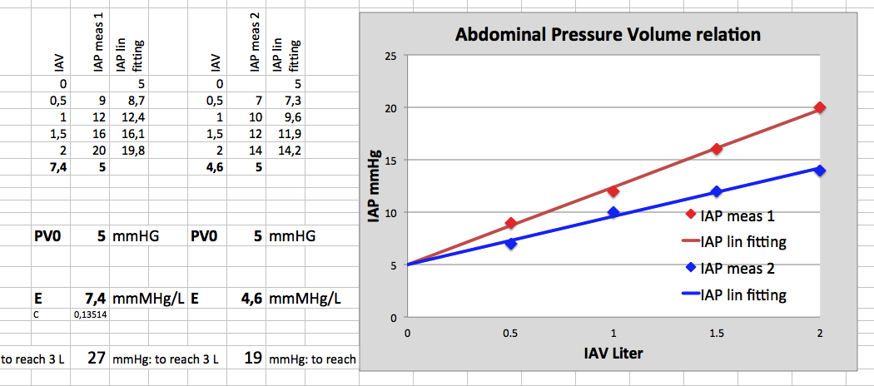
Ex. of three point calculation in the OR

Slide 16
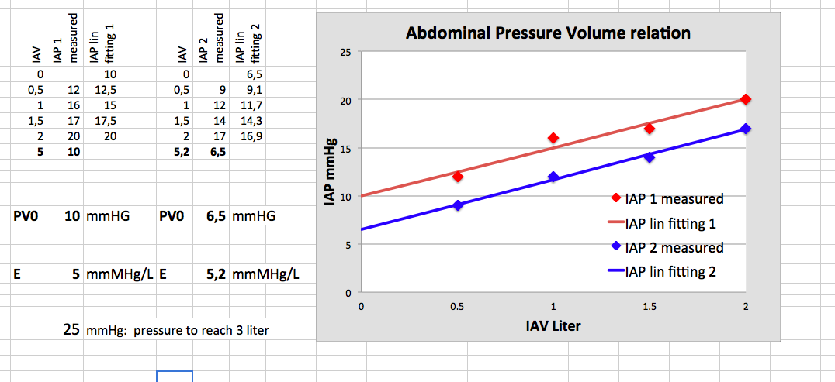
Per operative measurements at first inflation

Slide 17
3. Fast clinical guess at first insufflation
Set insufflator at fixed pressure: ex 15 mmHg
Measure inflated volume: X liter
If < 2 liter: problem difficult to solve
  Deep NMB, higher IAP, laparotomy,…
If < 4 liter: maximal therapy helps
  Deep NMB, keep IAP
If > 4 liter: choice:
  Reduce IAP and keep deep NMB
  Keep IAP 15 and reduce NMB

Slide 18
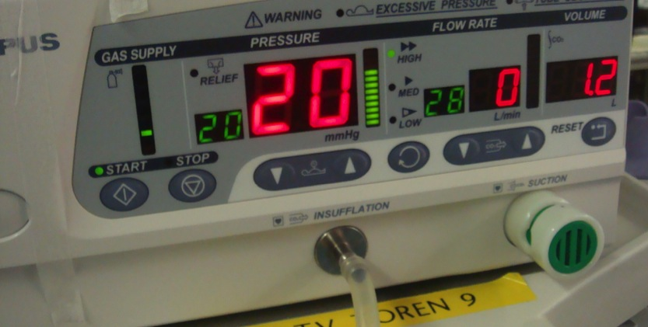
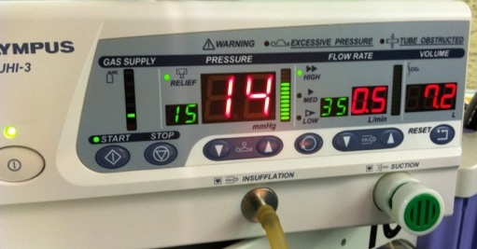
3. Example: 1,2 L versus 7,2 L
Deep NMB do not help sufficient
NMB needed?
Yes and drop the IAP

Slide 19
Practical Team Work
Video with NMB abdominal compliance measuring

Slide 20
Can we predict difficulty?

Slide 21
Determinants of E and PV0
 | PV0 | P_{VO} sig | E | E sig
Age | Neg | 0.828 | Pos | 0.003*
Length | Neg | 0.356 | Neg | 0.245
Body weigth | Pos | 0.012* | Pos | 0.294
Bmi | neg | 0.054 | Neg | 0.272
Sex | Neg | 0.596 | Neg | 0.536
Gravidity | Neg | 0.305 | Neg | 0.049*
Prev abd operation | Neg | 0.191 | Neg | 0.009*
Muscle relaxation | Neg | 0.001* | Neg | 0.376
* Sig p<0.05
Mulier JP 2007

Slide 22
Can we do something?

Slide 23
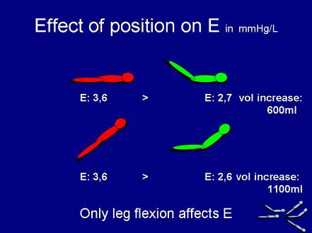
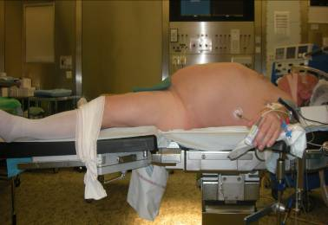
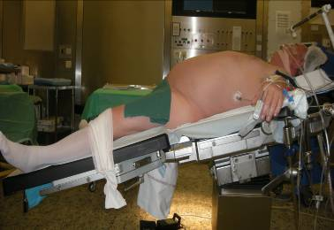
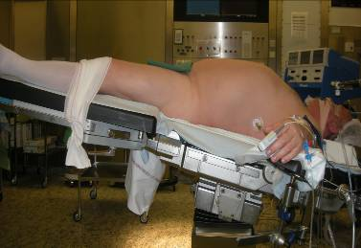
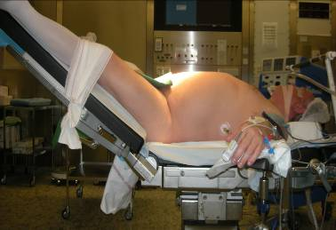
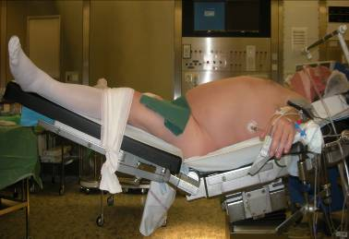
How to change C : hip flexion
Mulier JP, Dillemans B Obes Surg 2010

Slide 24
Impact of patient’s body position on the laparoscopic workspace
Reverse trendelenburg Beach chair
E (mmHg/L) 3,6 2,6
PV0 (mmHg) 4,8 4,8
IAV (L) 2,99 3,76
Impact of the patient's body position on the intraabdominal workspace during laparoscopic surgery.
Mulier JP, Dillemans B, Van Cauwenberge S.
Surg Endosc. 2010.

Slide 25
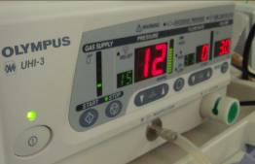
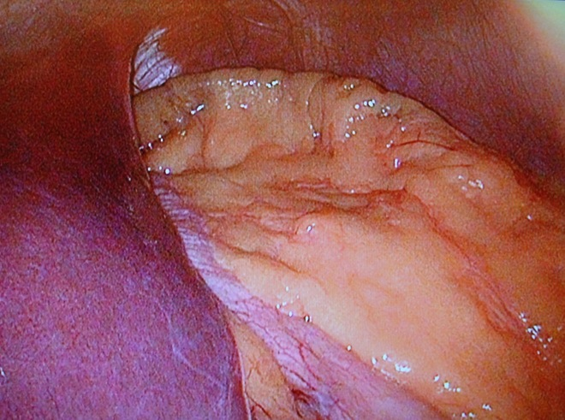
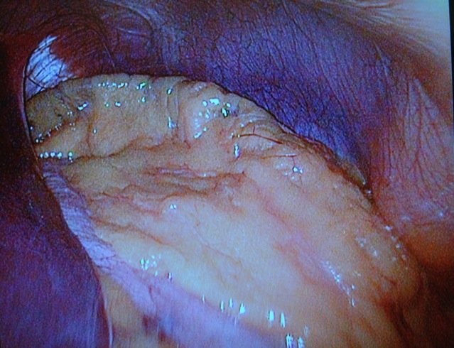
Surgical workspace effect of NMB in an obese patient BMI 46:
Volume IAP no NMB IAP deep NMB
  1 Liter 11 mmHg 8 mmHg
  2 Liter 13 mmHg 10 mmHg
  liter 15 mmHg 12 mmHg
  Liter - 14 mmHg
  Patient got inhalation of Desflurane at 1 Mac
  Remifentanyl infusion with no effect on relaxation
  Ventilation 600 ml 12 x with 7 cm H20 peep
  Rocuronium bolus of 1,2 mg/kg IBW with continuous infusion of 50 mg/hour was given after first measurements
  Second measurements when PTC < 3 at the thumb
Pressure 14 gives volume of 4 liter
Workspace. View is more from above
More space and better access
Pressure 15 gives volume of 3 liter
Workspace.

Slide 26
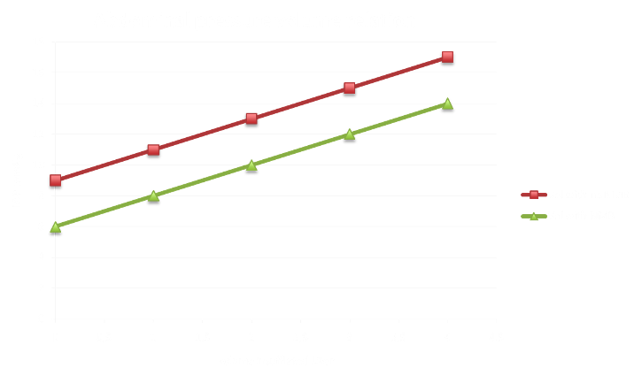
Abdominal Pressure Volume Relation obese patient BMI 46:
PV0 = 9 mmHg drops to 6 mmHg. E remains constant at 2 mmHg/liter

Slide 27
How improving workspace?
If high PV0 easy to improve
    NMB most effective, trendelenburg, IAP increase
If low C difficult to improve
    Flexing legs, higher IAP and NMB are less effective
NMB helps in both situations!

Slide 28
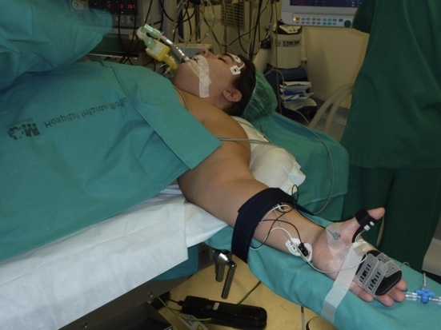
Case study
Woman; 26 years old;
She has never been pregnant
She had no comorbidities
She has had a weight loss of 16 kg
  Her height was 172 cm
  Last Christmas her weight was 132 kg
  On the day of surgery she weighed 116 kg
  Her BMI had dropped from 44.74 to 39.32
She had a cystic teratoma of the ovary
She was scheduled for Lap gastric by-pass and adnexectomy
Notes:
Leerlo simplemente

Slide 29
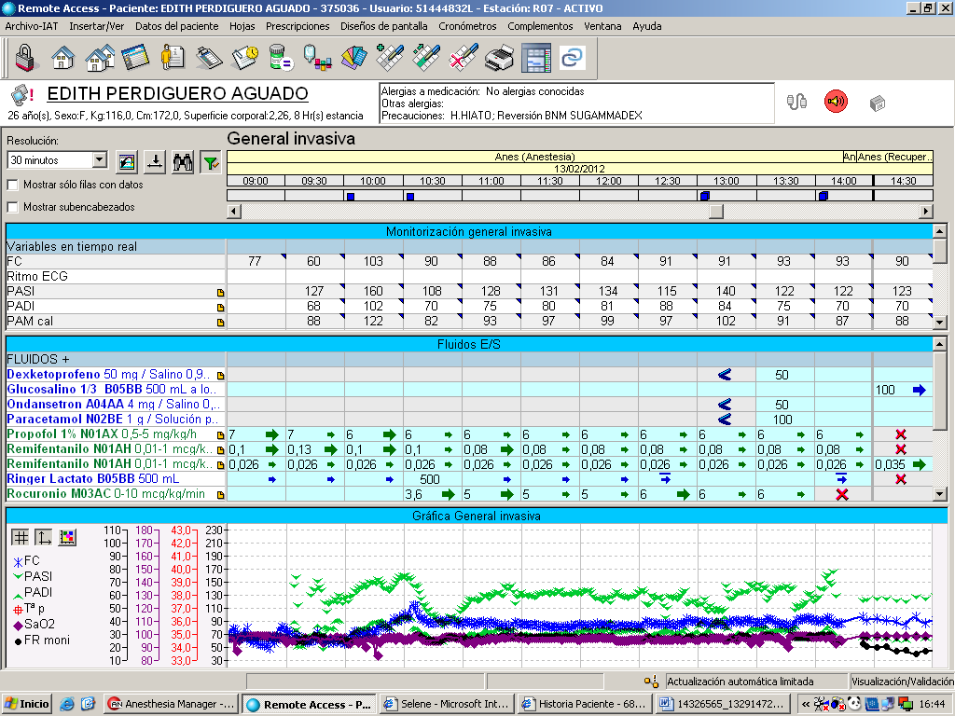
GASTRIC BY-PASS AND ADNEXECTOMY
Notes:
The procedure was done under a TCI of profol and remifentanil

Slide 30
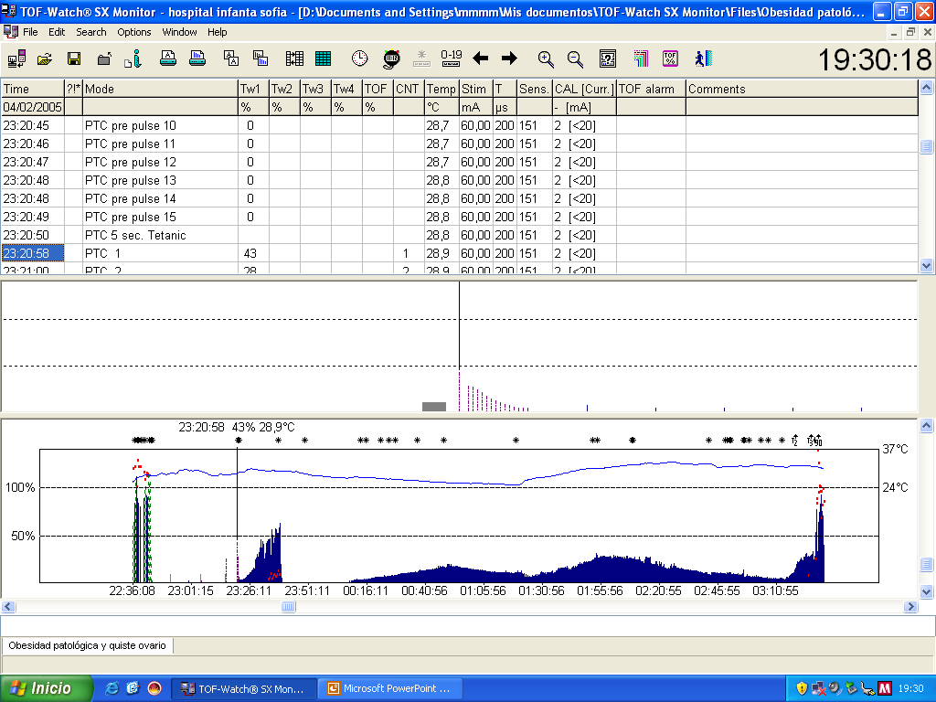
Rocuronium 5-7 ug/kg/min for 1-2 TOF
Gastric By-pass
Adnexectomy
IAP 11-12 mmHG
IAP 13-14 mmHG
Notes:
After 0.6 mg/k of rocuronium the patient was intubated and we achieved a deep block
At this point having the patiente 8-10 PTCs (señalar y poner foto de aguja de verres), we made the measure of the APVR and we calculate the PV0 and the Elastance
We noticed that a deep block was not necessary so we keep the patient on a shadow block just with 1-2 TOF response at AP with a continium infusion of rocuronium beteween 5-7 ug/kg/min
During the gastric bypass procedure, the patient was on a antitrebdelenburg position, the IAP was 11-12 mmHg and the surgeon had good surgical conditions and enough workspace
During the anexectomy procedure, the patient was changed to a trendelenburg position and the IAP rose to 13-14 mmHg, having the surgeon good surgycal conditions and enough workspace
You have to take into account for the patient had had in importan weight loss (which improve de elastence) and the gastric procedure was done in a antitrendelenburg position (which lower the PV0)

Slide 31
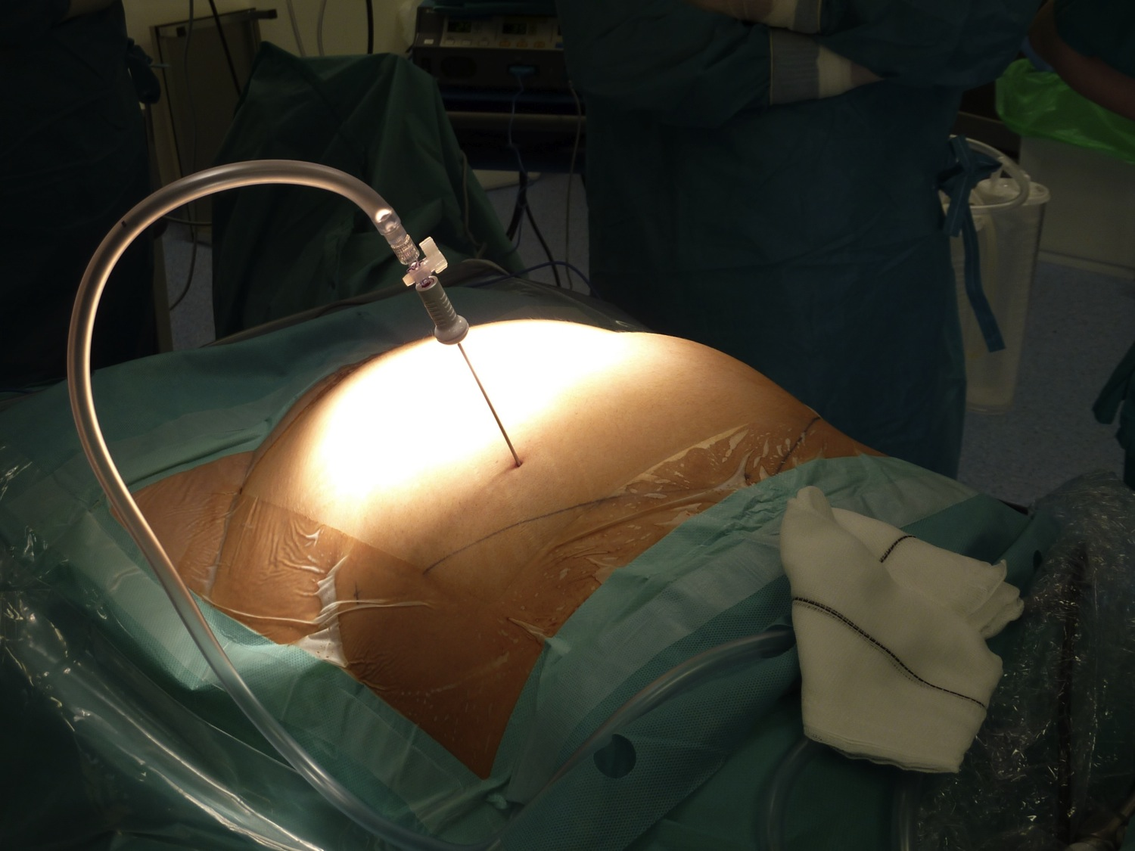

Slide 32
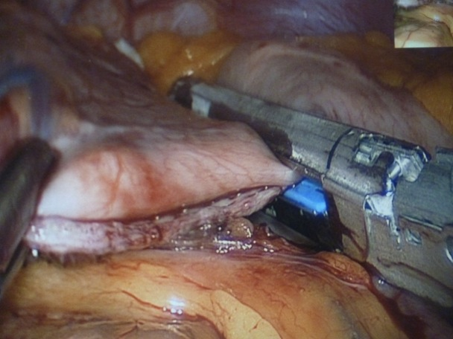
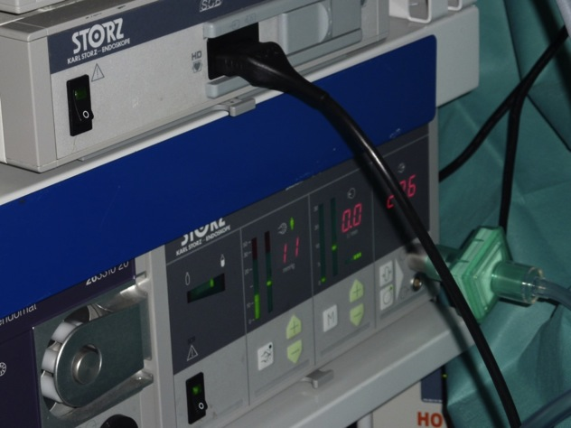
Gastric by-pass

Slide 33
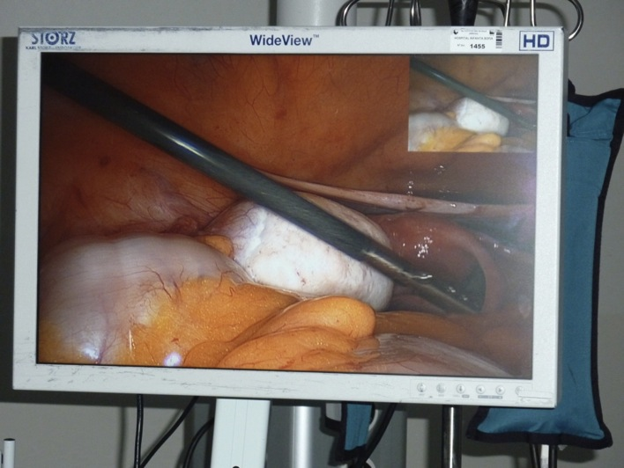
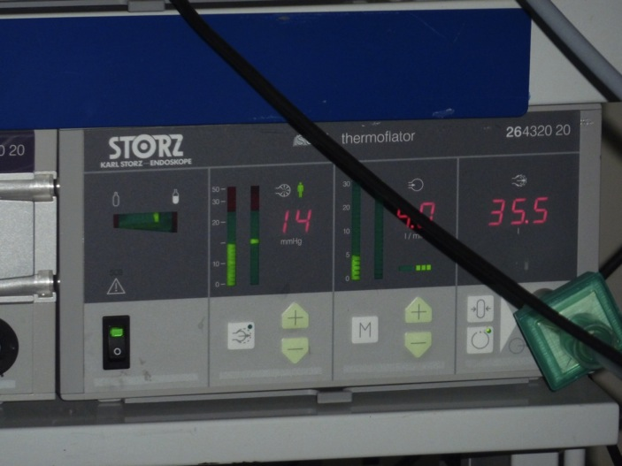
Adnexectomy

Slide 34
Sugammadex and Rocuronium Bromide Indications and Safety Information
Notes:
Full prescribing information should be consulted before use of any product.

Slide 35
Therapeutic Indications for BRIDION® (sugammadex)¹
Indications
BRIDION is indicated for the reversal of neuromuscular blockade induced by rocuronium or vecuronium.
In children and adolescents (aged 2-17 years), BRIDION is recommended only for routine reversal of moderate rocuronium-induced neuromuscular blockade.
There are no data to recommend BRIDION for immediate reversal following vecuronium-induced blockade.
Dosage and Administration
BRIDION should be administered only by, or under the supervision of, an anaesthetist. Neuromuscular monitoring is recommended during recovery of neuromuscular blockade. Ventilatory support is mandatory for patients until adequate spontaneous respiration is restored following reversal. Even if recovery from neuromuscular blockade is complete, other medicinal products used in the peri- and postoperative period could depress respiratory function and, therefore, ventilatory support might still be required.
If neuromuscular blockade is required within 24 hours of BRIDION administration, a nonsteroidal neuromuscular blocking agent should be used instead of rocuronium or vecuronium.
1. BRIDION® (sugammadex). Summary of Product Characteristics. November 2010.

Slide 36
Selected Safety Information About BRIDION® (sugammadex)¹ (continued)
Contraindications
BRIDION is contraindicated in patients hypersensitive to sugammadex or any of its excipients.
Precautions and Drug Interactions
BRIDION is not recommended in patients with severe renal impairment (including patients requiring dialysis [CrCl <30 mL/min]). Studies in patients with hepatic impairment have not been conducted and, therefore, patients with severe hepatic impairment should be treated with great caution.
Caution should be exercised when administering BRIDION to pregnant women as no clinical data on exposed pregnancies are available.
BRIDION has not been investigated in patients receiving rocuronium or vecuronium in the ICU setting.
Side Effects
The most commonly reported adverse reactions were dysgeusia (metal or bitter taste) and anesthetic complications (eg, movement, coughing, grimacing, or suckling on the endotracheal tube). In patients treated with BRIDION, a few cases of awareness were reported. The relationship to BRIDION was uncertain. Drug hypersensitivity reactions: Hypersensitivity reactions, including anaphylaxis, have occurred in some patients and volunteers. In clinical trials of surgical patients these reactions were reported uncommonly and for postmarketing reports the frequency is unknown. These reactions varied from isolated skin reactions to serious systemic reactions (ie, anaphylaxis, anaphylactic shock) and have occurred in patients with no prior exposure to sugammadex. Symptoms associated with these reactions can include: flushing, urticaria, erythematous rash, (severe) hypotension, tachycardia and swelling of tongue and pharynx. Clinicians should be prepared for the possibility of allergic reactions and take the necessary precautions.
1. BRIDION® (sugammadex). Summary of Product Characteristics. November 2010.

Slide 37
Selected Safety Information About BRIDION® (sugammadex)¹ (continued)
In a trial of patients with a history of pulmonary complications, bronchospasm was reported in 2 patients and a causal relationship could not be fully excluded.
Volunteer studies have demonstrated a slight (17% to 22%) and transient (≤30 minutes) prolongation of the PT/aPTT with BRIDION; however, clinical studies have demonstrated no clinically relevant effect on peri- or postoperative bleeding complications with BRIDION alone or in combination with anticoagulants. As BRIDION has demonstrated an in vitro pharmacodynamic interaction with anticoagulants, caution should be exercised in patients on anticoagulation for a pre-existing or comorbid condition. This pharmacodynamic interaction is not clinically relevant for patients receiving routine postoperative prophylactic anticoagulation.
Although formal interaction studies have not been conducted, no drug interactions were observed in clinical trials. Preclinical data suggest that clinically significant drug interactions are unlikely with the possible exceptions of toremifene, fusidic acid, and hormonal contraceptives.
1. BRIDION® (sugammadex). Summary of Product Characteristics. November 2010.

Slide 38
Therapeutic Indications for ESMERON® (rocuronium bromide)¹
Indications
ESMERON is indicated as an adjunct to general anesthesia to facilitate tracheal intubation during routine and rapid sequence induction, and to provide skeletal muscle relaxation during surgery. ESMERON is also indicated as an adjunct in the intensive care unit (ICU) to facilitate intubation and mechanical ventilation.
For the pediatric population: ESMERON is indicated as an adjunct to general anesthesia to facilitate tracheal intubation during routine induction and to provide skeletal muscle relaxation during surgery in pediatric patients from term newborn infants to adolescents.
1. ESMERON® (rocuronium bromide). Summary of Product Characteristics. March 2008.

Slide 39
Selected Safety Information About ESMERON® (rocuronium bromide)¹
Contraindications
Hypersensitivity to rocuronium or to the bromide ion or to any of the excipients.
Warnings and Precautions
Since ESMERON causes paralysis of the respiratory muscles, ventilatory support is mandatory for patients treated with this drug until adequate spontaneous respiration is restored. As with all neuromuscular blocking agents, it is important to anticipate intubation difficulties, particularly when used as part of a rapid sequence induction technique. In case of intubation difficulties resulting in a clinical need for immediate reversal of a rocuronium induced neuromuscular block, the use of sugammadex should be considered.
As with other neuromuscular blocking agents, residual curarization has been reported for ESMERON. In order to prevent complications resulting from residual curarization, it is recommended to extubate only after the patient has recovered sufficiently from neuromuscular block. Other factors that could cause residual curarization after extubation in the postoperative phase (eg, drug interactions or patient condition) should also be considered. If not used as part of standard clinical practice, the use of sugammadex or another reversal agent should be considered, especially in those cases where residual curarization is more likely to occur.
1. ESMERON® (rocuronium bromide). Summary of Product Characteristics. March 2008.

Slide 40
Selected Safety Information About ESMERON® (rocuronium bromide)¹ (continued)
Anaphylactic reactions can occur following the administration of neuromuscular blocking agents. Precautions for treating such reactions should always be taken. Particularly in the case of previous anaphylactic reactions to neuromuscular blocking agents, special precautions should be taken since allergic cross-reactivity to neuromuscular blocking agents has been reported.
In general, following long-term use of neuromuscular blocking agents in the ICU, prolonged paralysis and/or skeletal muscle weakness has been noted. In order to help preclude possible prolongation of neuromuscular block and/or overdosage it is strongly recommended that neuromuscular transmission is monitored throughout the use of neuromuscular blocking agents. In addition, patients should receive adequate analgesia and sedation. Furthermore,
neuromuscular blocking agents should be titrated to effect in the individual patients by or under supervision of experienced clinicians who are familiar with their actions and with appropriate neuromuscular monitoring techniques.
Myopathy after long-term administration of other nondepolarizing neuromuscular blocking agents in the ICU in combination with corticosteroid therapy has been reported regularly. Therefore, for patients receiving both neuromuscular blocking agents and corticosteroids,
the period of use of the neuromuscular blocking agent should be limited as much as possible.
1. ESMERON® (rocuronium bromide). Summary of Product Characteristics. March 2008.

Slide 41
Selected Safety Information About ESMERON® (rocuronium bromide)¹ (continued)
If suxamethonium is used for intubation, the administration of ESMERON should be delayed until the patient has clinically recovered from the neuromuscular block induced by suxamethonium.
The following conditions may influence the pharmacokinetics and/or pharmacodynamics of ESMERON: hepatic and/or biliary tract disease and renal failure; prolonged circulation time; neuromuscular disease, hypothermia, obesity, burns.
Conditions that may increase the effects of ESMERON: hypokalaemia (eg, after severe vomiting, diarrhea and diuretic therapy), hypermagnesemia, hypocalcemia (after massive transfusions), hypoproteinemia, dehydration, acidosis, hypercapnia, cachexia.
Drug Interactions
The following drugs have been shown to influence the magnitude and/or duration of action of ESMERON. Increased effect: halogenated volatile anesthetics, after intubation with suxamethonium, long-term concomitant use of corticosteroids may result in prolonged duration of neuromuscular block or myopathy; other drugs—some antibiotics (aminoglycoside, lincosamide and polypeptide antibiotics, acylamino-penicillin antibiotics),
diuretics, quinidine and quinine, magnesium salts, calcium channel blocking agents, lithium salts, local anesthetics (lidocaine i.v., bupivacaine epidural), and acute administration of phenytoin or ß-blocking agents.
1. ESMERON® (rocuronium bromide). Summary of Product Characteristics. March 2008.

Slide 42
Selected Safety Information About ESMERON® (rocuronium bromide)¹ (continued)
Recurarization has been reported after postoperative administration of: aminoglycoside, lincosamide, polypeptide and acylamino-penicillin antibiotics,
quinidine, quinine, and magnesium salts.
Decreased effect: prior chronic administration of phenytoin or carbamazepine,
protease inhibitors (gabexate, ulinastatin)
Variable effect: administration of other nondepolarizing neuromuscular blocking agents in combination with ESMERON may produce attenuation or potentiation of the neuromuscular block, depending on the order of administration and the neuromuscular blocking agent used. Suxamethonium given after the administration of ESMERON may produce potentiation or attenuation of the neuromuscular blocking effect of ESMERON. ESMERON combined with lidocaine may result in a quicker onset of action of lidocaine.
Pediatric patients
No formal interaction studies have been performed. The above mentioned interactions for adults and their special warnings and precautions for use should also be taken into account for pediatric patients.
1. ESMERON® (rocuronium bromide). Summary of Product Characteristics. March 2008.

Slide 43
Selected Safety Information About ESMERON® (rocuronium bromide)¹ (continued)
Adverse Events
The most commonly occurring adverse drug reactions include injection site pain/reaction, changes in vital signs and prolonged neuromuscular block. The most frequently reported serious adverse drug reactions during postmarketing surveillance are anaphylactic and anaphylactoid reactions and associated symptoms.
Although very rare, severe anaphylactic reactions to neuromuscular blocking agents,
including ESMERON, have been reported. Anaphylactic/anaphylactoid reactions are: bronchospasm, cardiovascular changes (eg, hypotension, tachycardia, circulatory collapse–shock), and cutaneous changes (eg, angioedema, urticaria). These reactions have, in some cases, been fatal. Due to the possible severity of these reactions, one should always assume they may occur and take the necessary precautions. Since neuromuscular blocking agents are known to be capable of inducing histamine release both locally at the site of injection and systemically, the possible occurrence of itching and erythematous reactions at the site of injection and/or generalized histaminoid (anaphylactoid) reactions should always be taken into consideration when administering these drugs. In clinical studies only a slight increase in mean plasma histamine levels has been observed following rapid bolus administration of rocuronium bromide 0.3-0.9 mg.kg⁻¹.
1. ESMERON® (rocuronium bromide). Summary of Product Characteristics. March 2008.

Slide 44
Selected Safety Information About ESMERON® (rocuronium bromide)¹ (continued)
Pediatric patients
A meta-analysis of 11 clinical studies in pediatric patients (N=704) with rocuronium bromide (up to 1 mg/kg) showed that tachycardia was identified as adverse drug reaction with a frequency of 1.4%.
1. ESMERON® (rocuronium bromide). Summary of Product Characteristics. March 2008.

Slide 45

For additional safety information, please consult the Summary of Product Characteristics.
Copyright © 2011 Merck Sharp & Dohme Corp., a subsidiary of Merck & Co., Inc., Whitehouse Station, NJ, USA.
All rights reserved. ANES-1021472-0000 01/12

Slide 46
But if patient breaths against ventilator: Valsalva effect
Valsalva is an active muscle contraction different from breathing
  It increases the abdominal pressure to block inspiration
Preventable by support ventilation

Slide 47
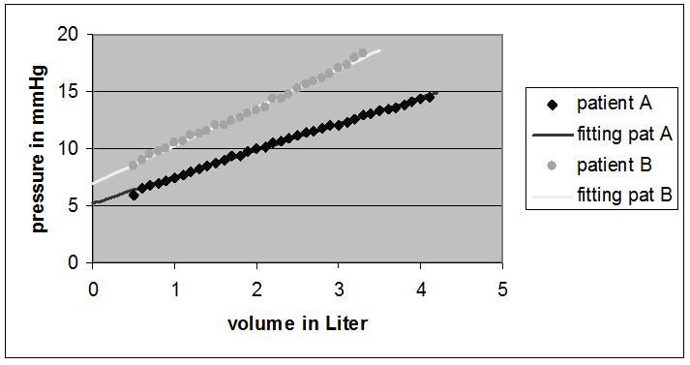
BMI effect on abdominal P/V relation
J Mulier ISPUB 2009
  Pressure volume relation is linear
  PV0 and E define each patient
J Mulier IFSO 2007

Slide 48
E en PV0 determined by ?
Mulier Dillemans ESA 2007
factors | PV0 | P_{VO} sig | E | E sig
Age | Neg | 0.828 | Pos | 0.003*
Length | Neg | 0.356 | Neg | 0.245
Body weigth | Pos | 0.012* | Pos | 0.294
Bmi | neg | 0.054 | Neg | 0.272
Sex | Neg | 0.596 | Neg | 0.536
Gravidity | Neg | 0.305 | Neg | 0.049*
Prev abd operation | Neg | 0.191 | Neg | 0.009*
Muscle relaxation | Neg | 0.001* | Neg | 0.376
* Sig p<0.05

Slide 49

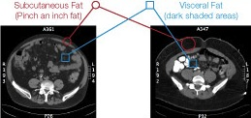
Two types of android obesity
Subcutaneus Fat Visceral fat
Intra visceral adiposity Extra visceral adiposity
Subcutaneus fat is scant and Subcutaneus fat is thick and
intra abdominal fat is thick and intra abdominal fat is scant.

Slide 50
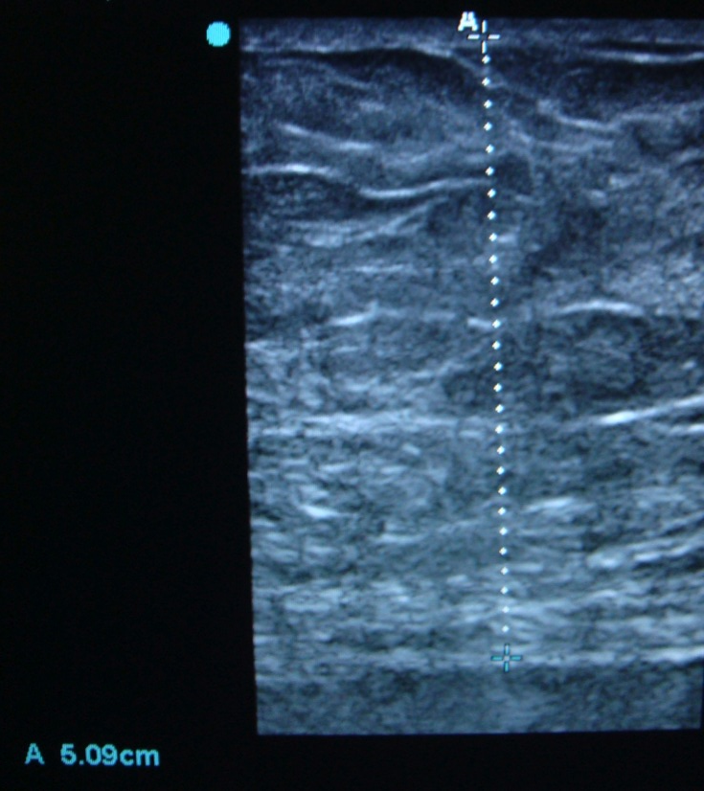
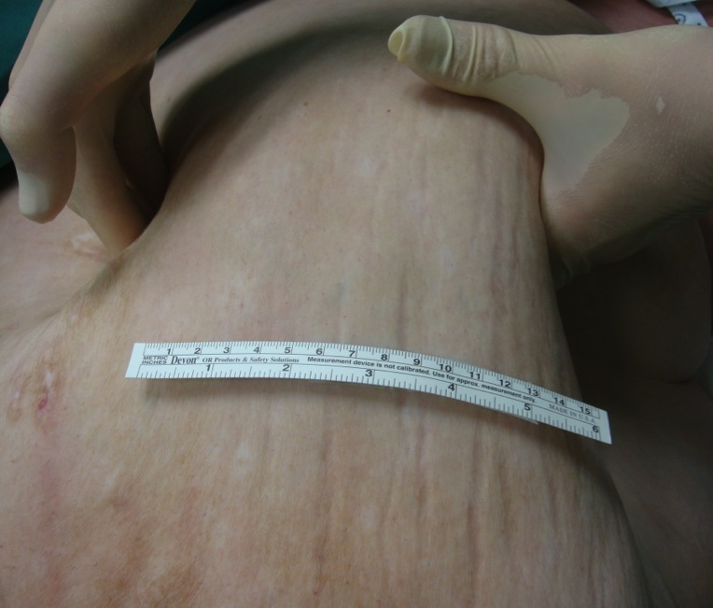
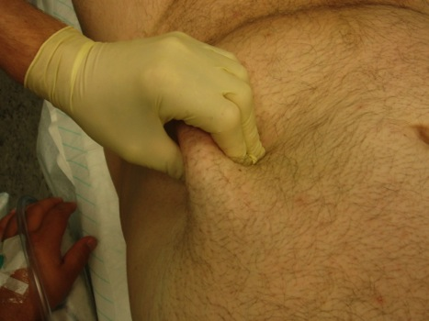
Dikte uitwendig/inwendig vet

Slide 51
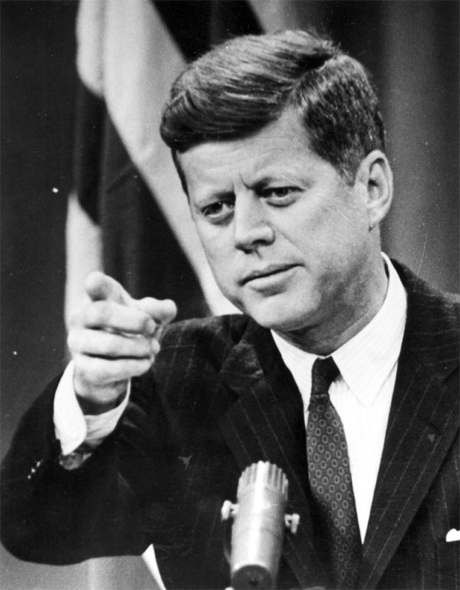
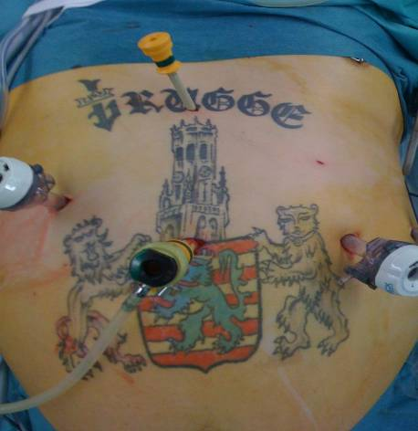
Same question to the surgeons
J F Kennedy:
  Inventor of the transdisciplinarity
‘Ask not only what the anaesthesiologist can do for you, ask also what you can do for the anaesthesiologist.’

Slide 52





Become member ESPCOP
Secretary
Luc De baerdemaeker
President
Jan P Mulier
Treasurer
Nick Kennedy
Vice-President
Yigal Leykin
www.publicationslsit.org/ESPCOP
www.espcop.org

Slide 53
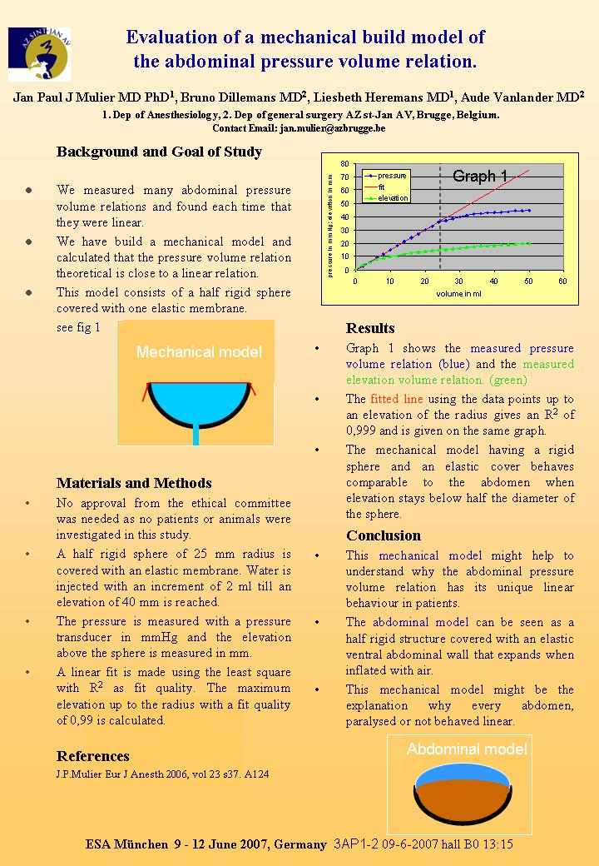
Waarom is relatie lineair ?
Toevallig lineair ?
Fysische (niet fysiologische) verklaring
Een ballon is nooit lineair
Halve ballon waarbij de kromtestraal afneemt ipv toe te nemen bij stijgend volume

Slide 54
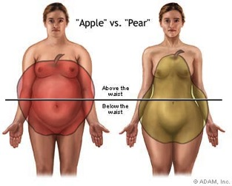
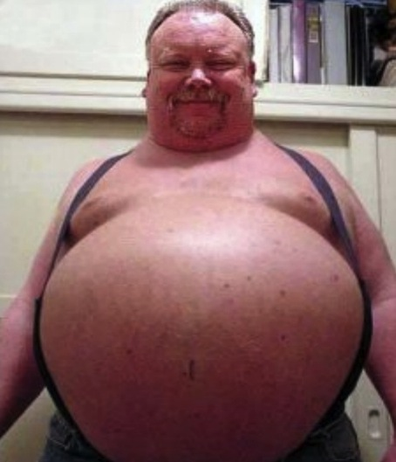

Obesity type
Android vs Gynoid
WHR>1.2 WHR<0.8

Slide 55
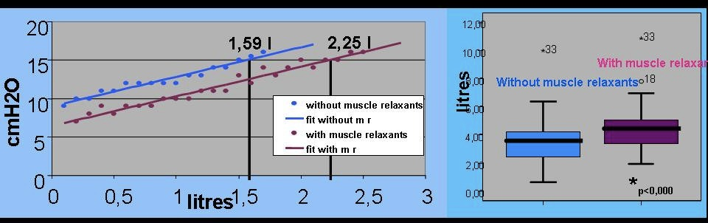
NMB effect on E - PV0
E or Compliance unchanged by NMB
  E determined by fascia, size and shape
PV0 drops by NMB
  = extra volume at same pressure

